Slide 1

Diploma Studies
Computer Engineering
Unit – 6
Title - Memory Organization
Computer Organization (09CE2401)
Memory Organization

Slide 2
Memory Hierarchy

Slide 3
Memory Hierarchy
The Computer memory hierarchy looks like a pyramid structure which is used to describe the differences among memory types. It separates the computer storage based on hierarchy.
Level 0: CPU registers
Level 1: Cache memory
Level 2: Main memory or primary memory
Level 3: Magnetic disks or secondary memory
Level 4: Optical disks or magnetic types or tertiary Memory

Slide 4
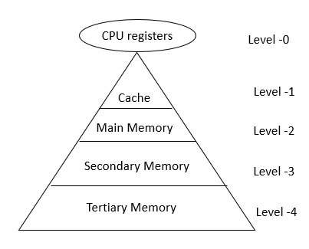
Memory Hierarchy

Slide 5
Memory Hierarchy
Level-0 − Registers
The registers are present inside the CPU. As they are present inside the CPU, they have least access time. Registers are most expensive and smallest in size generally in kilobytes. They are implemented by using Flip-Flops.
Level-1 − Cache
Cache memory is used to store the segments of a program that are frequently accessed by the processor. It is expensive and smaller in size generally in Megabytes and is implemented by using static RAM.
Level-2 − Primary or Main Memory
It directly communicates with the CPU and with auxiliary memory devices through an I/O processor. Main memory is less expensive than cache memory and larger in size generally in Gigabytes. This memory is implemented by using dynamic RAM.
Level-3 − Secondary storage
Secondary storage devices like Magnetic Disk are present at level 3. They are used as backup storage. They are cheaper than main memory and larger in size generally in a few TB.
Level-4 − Tertiary storage
Tertiary storage devices like magnetic tape are present at level 4. They are used to store removable files and are the cheapest and largest in size (1-20 TB).

Slide 6
Main Memory

Slide 7
Main Memory
The main memory acts as the central storage unit in a computer system. It is a relatively large and fast memory which is used to store programs and data during the run time operations.
The primary technology used for the main memory is based on semiconductor integrated circuits. The integrated circuits for the main memory are classified into two major units.
RAM (Random Access Memory) integrated circuit chips
ROM (Read Only Memory) integrated circuit chips

Slide 8
RAM Integrated Circuit Chips
The RAM integrated circuit chips are further classified into two possible operating modes, static and dynamic.
The primary compositions of a static RAM are flip-flops that store the binary information. The nature of the stored information is volatile, i.e. it remains valid as long as power is applied to the system. The static RAM is easy to use and takes less time performing read and write operations as compared to dynamic RAM.
The dynamic RAM exhibits the binary information in the form of electric charges that are applied to capacitors. The capacitors are integrated inside the chip by MOS transistors. The dynamic RAM consumes less power and provides large storage capacity in a single memory chip.

Slide 9
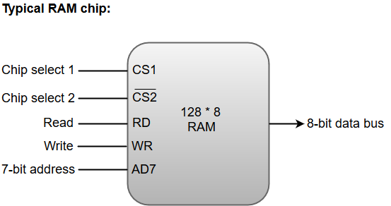
RAM Integrated Circuit Chips
RAM chips are available in a variety of sizes and are used as per the system requirement. The following block diagram demonstrates the chip interconnection in a 128 * 8 RAM chip.

Slide 10
RAM Integrated Circuit Chips
A 128 * 8 RAM chip has a memory capacity of 128 words of eight bits (one byte) per word. This requires a 7-bit address and an 8-bit bidirectional data bus.
The 8-bit bidirectional data bus allows the transfer of data either from memory to CPU during a read operation or from CPU to memory during a write operation.
The read and write inputs specify the memory operation, and the two chip select (CS) control inputs are for enabling the chip only when the microprocessor selects it.
The bidirectional data bus is constructed using three-state buffers.
The output generated by three-state buffers can be placed in one of the three possible states which include a signal equivalent to logic 1, a signal equal to logic 0, or a high-impedance state.

Slide 11
ROM Integrated Circuit Chips
The primary component of the main memory is RAM integrated circuit chips, but a portion of memory may be constructed with ROM chips.
A ROM memory is used for keeping programs and data that are permanently resident in the computer.
Apart from the permanent storage of data, the ROM portion of main memory is needed for storing an initial program called a bootstrap loader. The primary function of the bootstrap loader program is to start the computer software operating when power is turned on.
ROM chips are also available in a variety of sizes and are also used as per the system requirement. The following block diagram demonstrates the chip interconnection in a 512 * 8 ROM chip.

Slide 12
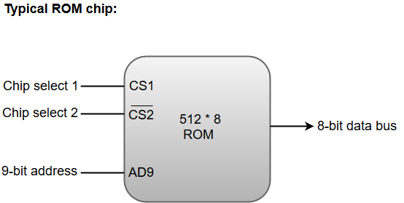
ROM Integrated Circuit Chips
A ROM chip has a similar organization as a RAM chip. However, a ROM can only perform read operation; the data bus can only operate in an output mode.
The 9-bit address lines in the ROM chip specify any one of the 512 bytes stored in it.
The value for chip select 1 and chip select 2 must be 1 and 0 for the unit to operate. Otherwise, the data bus is said to be in a high-impedance state.

Slide 13
Auxiliary Memory

Slide 14
Auxiliary Memory
An Auxiliary memory is known as the lowest-cost, highest-capacity and slowest-access storage in a computer system. It is where programs and data are kept for long-term storage or when not in immediate use.
The most common examples of auxiliary memories are magnetic tapes and magnetic disks.

Slide 15
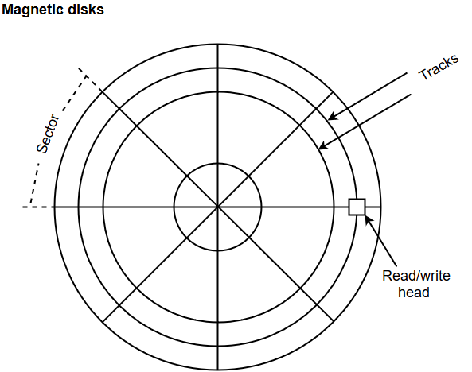
Magnetic Disks
A magnetic disk is a type of memory constructed using a circular plate of metal or plastic coated with magnetized materials. Usually, both sides of the disks are used to carry out read/write operations.
However, several disks may be stacked on one spindle with read/write head available on each surface.
The memory bits are stored in the magnetized surface in spots along the concentric circles called tracks.
The concentric circles (tracks) are commonly divided into sections called sectors.

Slide 16
Magnetic Tape
Magnetic tape is a storage medium that allows data archiving, collection, and backup for different kinds of data.
The magnetic tape is constructed using a plastic strip coated with a magnetic recording medium.
The bits are recorded as magnetic spots on the tape along several tracks. Usually, seven or nine bits are recorded simultaneously to form a character together with a parity bit.
Magnetic tape units can be halted, started to move forward or in reverse, or can be rewound.
However, they cannot be started or stopped fast enough between individual characters. For this reason, information is recorded in blocks referred to as records.

Slide 17
Associative Memory

Slide 18
Associative Memory
An associative memory can be considered as a memory unit whose stored data can be identified for access by the content of the data itself rather than by an address or memory location.
Associative memory is often referred to as Content Addressable Memory (CAM).
When a write operation is performed on associative memory, no address or memory location is given to the word. The memory itself is capable of finding an empty unused location to store the word.
On the other hand, when the word is to be read from an associative memory, the content of the word, or part of the word, is specified. The words which match the specified content are located by the memory and are marked for reading.

Slide 19
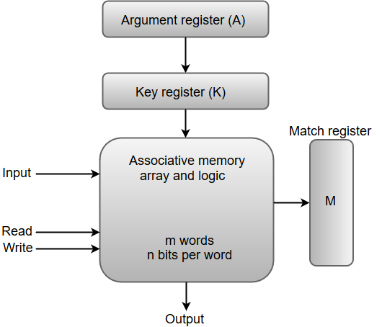
Associative Memory
From the block diagram, we can say that an associative memory consists of a memory array and logic for 'm' words with 'n' bits per word.
The functional registers like the argument register A and key register K each have n bits, one for each bit of a word. The match register M consists of m bits, one for each memory word.
The words which are kept in the memory are compared in parallel with the content of the argument register.
The key register (K) provides a mask for choosing a particular field or key in the argument word. If the key register contains a binary value of all 1's, then the entire argument is compared with each memory word.

Slide 20
Associative Memory
Otherwise, only those bits in the argument that have 1's in their corresponding position of the key register are compared. Thus, the key provides a mask for identifying a piece of information which specifies how the reference to memory is made.

Slide 21
Cache Memory

Slide 22
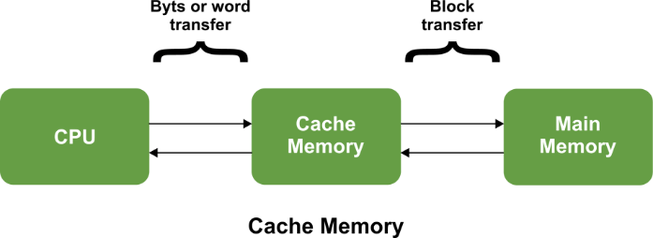
Cache Memory
The data or contents of the main memory that are used frequently by CPU are stored in the cache memory so that the processor can easily access that data in a shorter time.
Whenever the CPU needs to access memory, it first checks the cache memory. If the data is not found in cache memory, then the CPU moves into the main memory.
Cache memory is placed between the CPU and the main memory. The block diagram for a cache memory can be represented as:

Slide 23
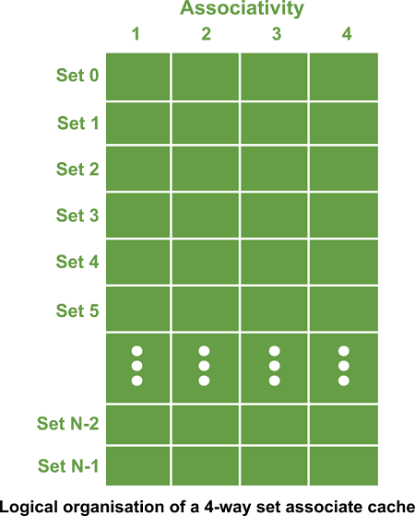
Cache Memory
The cache is the fastest component in the memory hierarchy and approaches the speed of CPU components.
Cache memory is organised as distinct set of blocks where each set contains a small fixed number of blocks.

Slide 24
Cache Memory
As shown in the above sets are represented by the rows. The example contains N sets and each set contains four blocks.
Whenever an access is made to cache, the cache controller does not search the entire cache in order to look for a match. Rather, the controller maps the address to a particular set of the cache and therefore searches only the set for a match.
If a required block is not found in that set, the block is not present in the cache and cache controller does not search it further.
This kind of cache organisation is called set associative because the cache is divided into distinct sets of blocks. As each set contains four blocks the cache is said to be four way set associative.

Slide 25
Cache Memory
The basic operation of a cache memory is as follows:
When the CPU needs to access memory, the cache is examined. If the word is found in the cache, it is read from the fast memory.
If the word addressed by the CPU is not found in the cache, the main memory is accessed to read the word.
A block of words one just accessed is then transferred from main memory to cache memory. The block size may vary from one word (the one just accessed) to about 16 words adjacent to the one just accessed.
The performance of the cache memory is frequently measured in terms of a quantity called hit ratio.
When the CPU refers to memory and finds the word in cache, it is said to produce a hit.
If the word is not found in the cache, it is in main memory and it counts as a miss.
The ratio of the number of hits divided by the total CPU references to memory (hits plus misses) is the hit ratio.

Slide 26
Virtual Memory

Slide 27
Virtual Memory
Virtual memory refers to a memory management method where computers use secondary memory to compensate for the scarcity of physical memory.
The technique is exploited by a computer’s operating system (OS) in situations when the system lacks sufficient RAM to execute instructions.
With virtual memory, computers can run complex and sophisticated programs as the conflicting memory demands of multiple programs are met within a fixed memory space.
Before virtual memory, systems used RAM and secondary memory. In the early 1940s and 1950s, computer memory was quite expensive. However, with time, computer programs became more complex, and developers feared that these large programs might consume all of a computer’s main memory and eventually run out of it.

Slide 28
Virtual Memory
This led to the development of virtual memory in the late 1950s. In 1959, researchers at the University of Manchester, England, developed the first virtual memory system for a computer named ‘Atlas.’ This was followed by Burroughs Corp’s development of the first commercial computer in 1961 with built-in virtual memory. Later in 1982, Intel incorporated a virtual memory component in the 80286 processor.
Fast-forward to today, we have systems with at least 8GB or 16GB of RAM. However, more is needed when you intend to run several programs simultaneously. That’s where virtual memory becomes vital.
Virtual memory transfers data from RAM to disk storage, mapping memory to disk files. The virtual memory swaps unused data from RAM to a storage device like a hard drive or solid-state drive (SSD) and frees up RAM for other tasks. As a result, computers tend to consider secondary and primary memory as one.

Slide 29
Virtual Memory
Virtual memory is crucial for multitasking. It enhances overall system performance as computers need not worry about memory constraints surrounding heavier programs.
Despite its advantages, virtual memory also has a negative side to it. It has been observed that virtual memory operates at much slower speeds than computer RAM.
If the OS juggles data between virtual memory and RAM continuously, it can slow down the computer considerably.
This can lead to a phenomenon called ‘thrashing.’ Users, therefore, cannot entirely rely on virtual memory as the overuse of virtual memory resources can inhibit application-level processing.
At the fundamental level, virtual memory maps program addresses to RAM. In cases where there’s not enough RAM space, the programs are mapped to disk.

Slide 30
Virtual Memory
The operating system uses two techniques to manage virtual memory, paging and segmentation.
Paging:
Under the paging approach, RAM is segregated into blocks of 4k sizes. These blocks are referred to as pages.
Computing processes are then allocated to these pages based on their memory needs. Each process may utilize less than 4k memory, so a portion of memory is bound to get wasted. In rare cases, some operations may use a large number of pages.
Under normal circumstances, these pages are swapped between RAM and page files representing virtual memory.

Slide 31
Virtual Memory
Segmentation:
Another approach to efficient memory management is that of segmentation.
Instead of allocating fixed-size pages to processes, memory segments of varied lengths are assigned to computing operations based on their memory needs. In contrast to paging, segmentation does not waste memory segments.
With segmentation, applications can split up into different logical address spaces. As a result, applications become shareable and more secure.
However, segmentation often leads to ‘memory fragmentation.’ Memory segments are of different lengths, and the allocation and deallocation of these segments result in many unused memory spaces. As their length is not defined, memory is left unattended by processes owing to their varying size.

Slide 32


